Slide 1
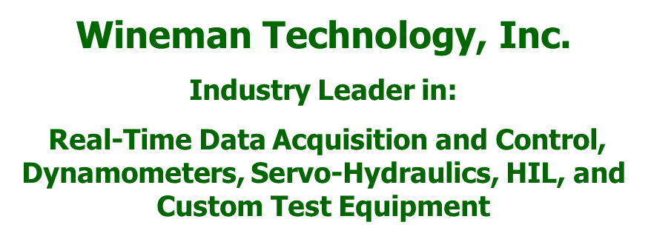
CANalytics
TM
CAN Interface Software
BY

Slide 2
Overview
A communication interface tool for engineers and software application developers that communicate over CAN networks.
CANalytics provides a powerful and configurable software application that:
Views all CAN traffic on a specific Bus
CAN Database Editor – Editing
Manages Database Files – allows importation/exportation of .dbc and .xml
Sends outgoing messages to a specific bus
Collects and Catalogs Bus Traffic – trace windows and log files
This application can be Accessed by any programing/scripting language that can make a TCP connection and serialize/de-serialize JSON data
The software also provides a LabVIEW API for communication with the Busses and the databases

Slide 3
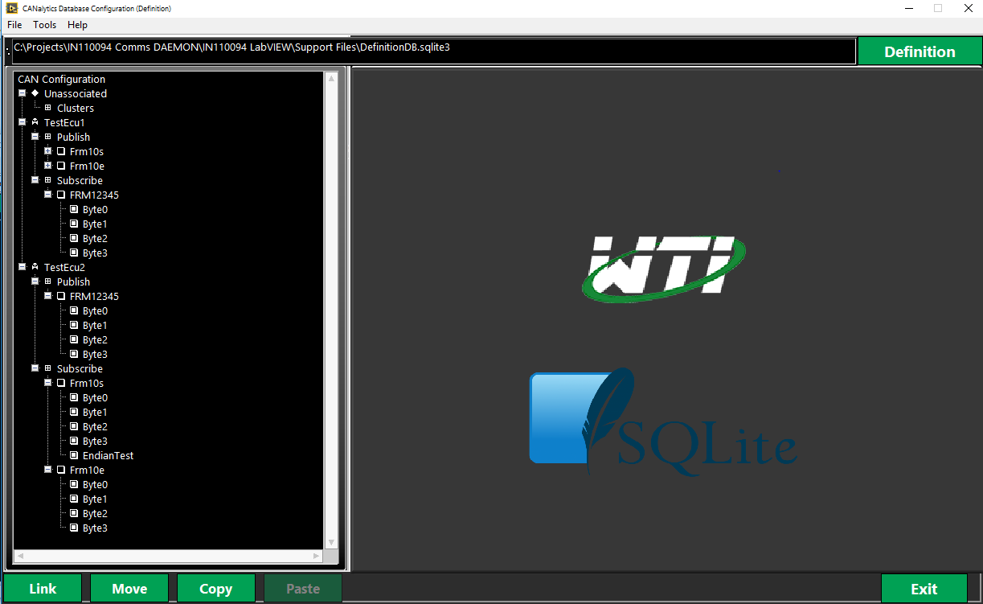
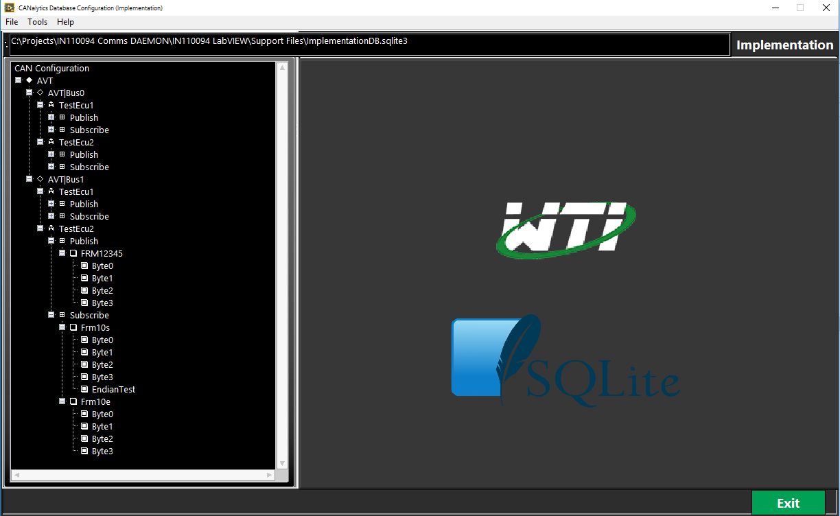
Database Configuration
Defines the customizable database that creates the hierarchy of the signals, frames, ECUs, interfaces, and hardware.

Slide 4
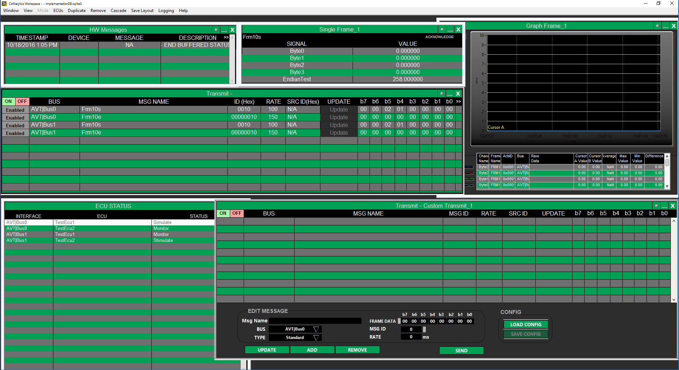
Developers Workspace
The CANalytics’s fully configurable user interface provides real-time bus traffic as well as an interface to allow the user to transmit messages to a specific bus .
Notes:
Interface to communicate with other systems via the CAN communications busses on the test stand
It allows for creating customized views of Bus Messages, viewing all traffic on a bus, or transmitting messages on a specific bus.

Slide 5
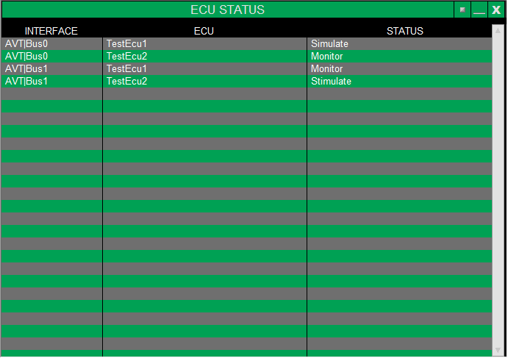
ECU Status
Defines the current status of each ECU on each Bus as well as allowing the user to change the status. The status of the ECU can also be changed in the run-time menu.
Notes:
Displays the status of an ECU
Allows the user to change the status of an ECU in the workspace
Kept up to date with the runtime menu

Slide 6
Transmit
Defines everything relating to the transmission of all messages from the developers workspace. Also used to edit the transmitted data of currently transmitted messages, enable/disable which messages are transmitted.
Notes:
Used for everything relating to the transmission of messages
It is used to edit the transmitted data of currently transmitted messages, enable/disable which messages are transmitted.

Slide 7
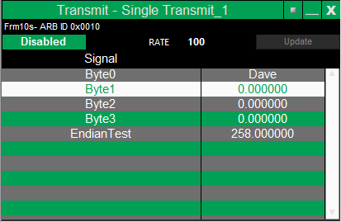
Single Transmit
Defines the current value for each signals and the frame rate of the frame that is being transmitted. Also used to edit the signal values and the frame rate.
Notes:
Defines the current values and allows the user to set the value for each signals on a single frame as well as set the frame rate.

Slide 8
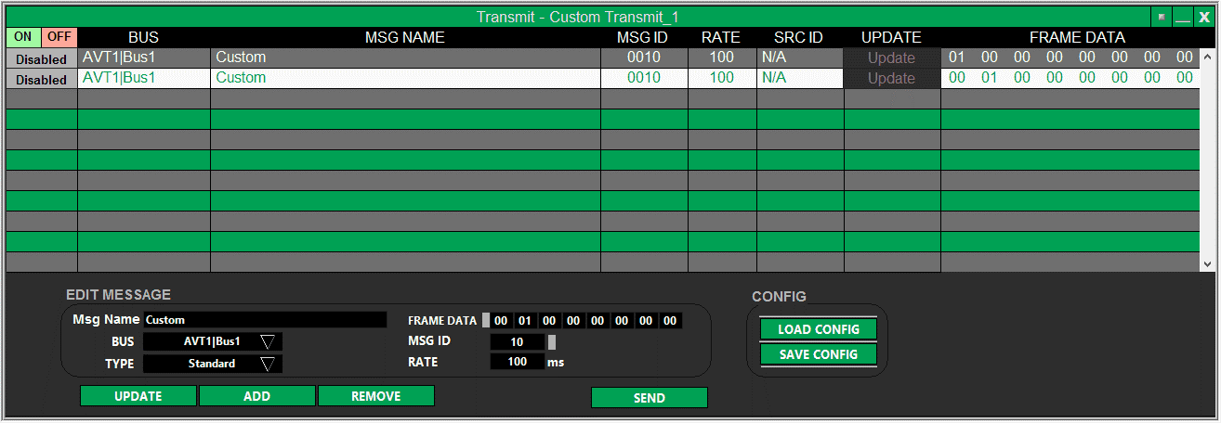
Custom Transmit
Create custom transmitted message that is undefined in the database. The message can be saved to a file for later use.
Notes:
This window is used to create custom transmitted messages, the messages can be saved, loaded, and edited.
This view provides an interface to send out custom messages on the FALCAN bus regardless of what was pre-configured in the Communications database.

Slide 9
Bus Monitor
Defines all Bus traffic in two views: Rolling and Fixed Trace. As well as can be filtered by events, Bus, message name, ARB ID and direction.
Notes:
Used to display all bus traffic in one single place as a Fixed or Rolling Trace.
The traffic can be filtered by Bus, name, ARB ID, and direction

Slide 10
Single Frame
Defines the current bus traffic for the specified frame and notified if the signal has went out of range and if has been acknowledged.
Notes:
This window allows the user to edit signal values on a single frame.

Slide 11
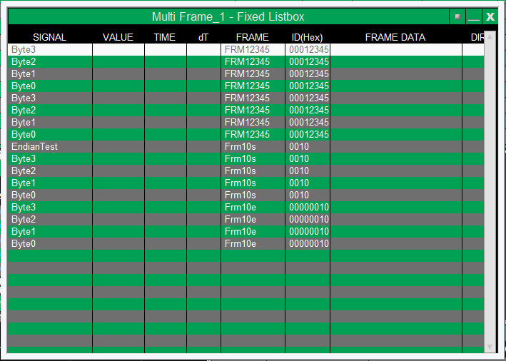
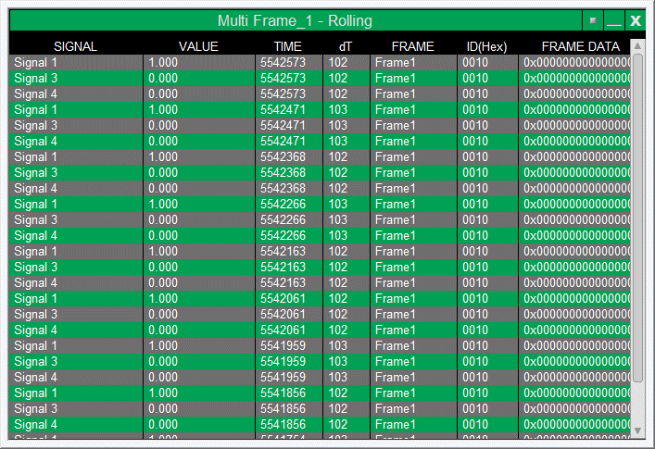
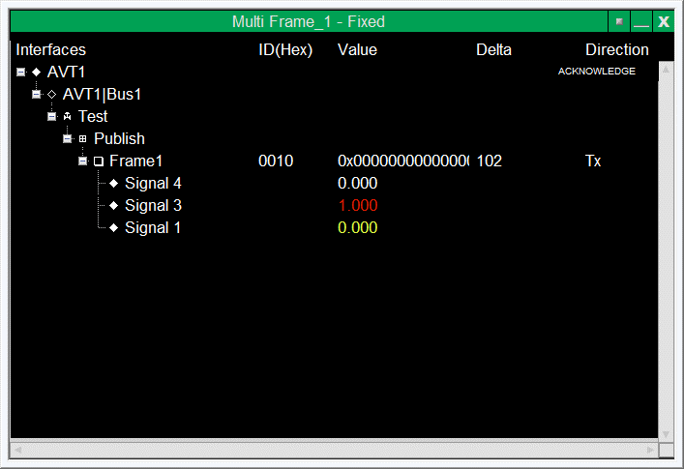
Multi Frame
Defines the bus traffic for a number specified of frames in three types of views: Rolling Trace, Fixed Trace, and Fixed List Box Trace. Each view can be configured in a real-time update mode or configured to update only when the data changes values.
Notes:
This Window has 6 different ways to view the Multiple Frame Trace: Rolling Trace, Rolling Trace (Events), Fixed Trace, Fixed Trace (Events), Fixed List Box Trace, and Fixed List Box Trace (Events). This Trace can be paused as well as log all data that passes through the Frame.

Slide 12
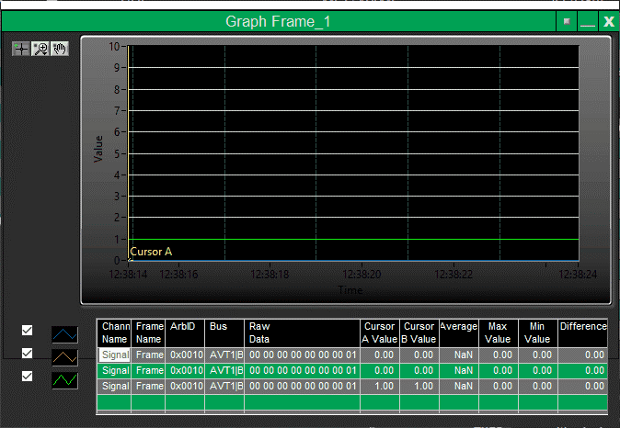
Graph Frame
Defines the values of signals underneath a number of specified frames of a graph, as well as a multi column list box that displays statistics on the signal.

Slide 13
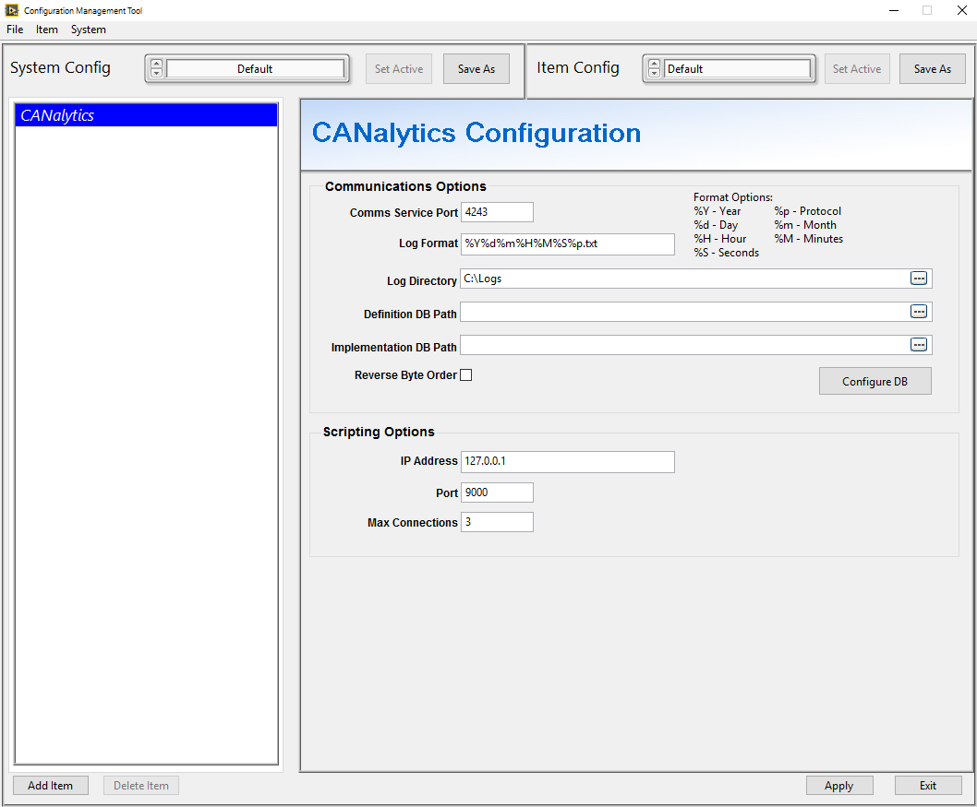
Configurations
Define the communication and scripting settings as well as file locations that are deployed through out the application.

Slide 14
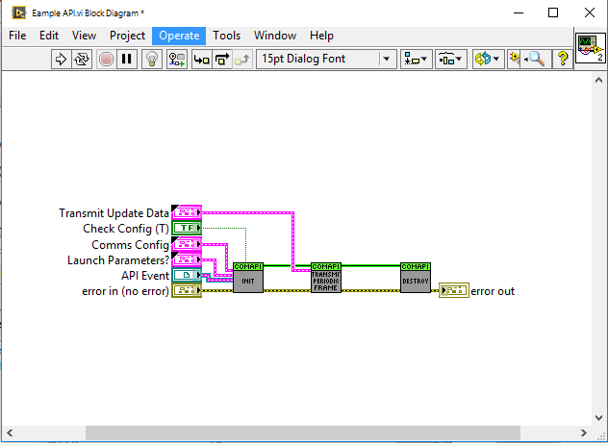
Support for LabVIEW
CANalytics provides an API for supporting LabVIEW and other programming/scripting languages. Client programs link to CANalytics’s Daemon to communicate with other systems via the CANalytic’s communications busses on the test stand.

Slide 15
Summary
Developers get a tool that that reduces development time of applications that require communication over CAN networks.
Cost Effective CAN Monitoring and Simulation tool
Reduces Application development time
Multi CAN hardware platform Support
Ability to add features in Timely manner as Requested

